Slide 1
Ready for a LIFE Changing EXPERIENCE?

Slide 2
Short Term Faculty-Led Study Abroad
STUDY ABROAD/AWAY OPPORTUNITIES
Long-term Study Abroad
National Student Exchange Program (NSE)
Duration 2-4 weeks
Affordable
International experience is valued by employers
Facilitated by an experienced faculty member
One semester or up to a year
You can choose a program in a foreign institution that is best suited to your academic needs
One semester or up to a year
Undergraduate students
Nationwide
Affordable
Meet the requirements of the NSE program
NSE.org

Slide 3
Steps to Apply for a Faculty-Led Study Abroad Program
Step 1. Study Abroad Application
Step 2. Submit required docs (passport, forms, etc.)
Step 3. Approval
Step 4. Apply for Scholarships/Financial Aid
Step 5. IOC Approval if applicable
Step 6. Pre-departure orientation & Cultural Assessment

Slide 4
1. Study Abroad Application
Non-refundable $125 application fee
Available for undergraduate, graduate and doctorate students
Essay with 1,000 words or less describing your motivation and impact expected from this experience
Picture of passport or the passport application/receipt
Unofficial transcript

Slide 5
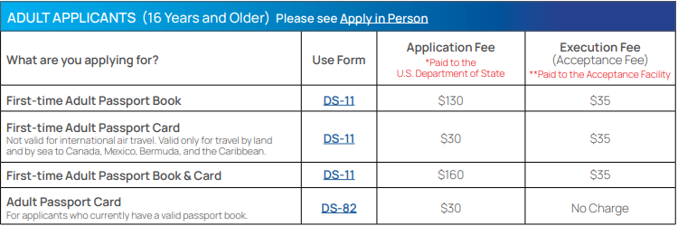
2. How to obtain a passport?
Website: www.Travel.State.Gov
Processing time is 6-9 weeks
Expedited shipping available with extra cost of $60 and takes 3-5 weeks
You must apply in person if it’s your first U.S. passport
Renew by mail if your current passport is undamaged

Slide 6
3. Approval
Once all supporting documentation and application is completed the review process finalizes
You will be notified if you have been approved
Travel and logistics will be communicated to you after the approval

Slide 7
4. Scholarship Opportunities
International Education Fee Scholarship
Provides funding between $1,000 - $1,200 per student
First-come first-served basis
To apply www.utrgv.edu/ipp
Gilman International Scholarship
Federal Scholarship
20 vaqueros were awarded $78,000 in AY 22-23 to fund study abroad Deadline March 9th
^{www.Gilmanscholarship.org}

Slide 8
4. Financial Aid to Study Abroad
You may receive federal student aid for a study-abroad program, if you meet the aid eligibility criteria. You’ll need to fill out a FAFSA form before you can receive federal student aid to study abroad.
Pell Grant
Subsidized and/or Unsubsidized Student Loans
Parent PLUS Loan - Available to qualified parents of dependent undergraduate students with financial aid eligibility. If there is a difference between the study abroad program budget and the amount of the student's financial aid, a parent may be eligible to apply for a Parent PLUS Loan. If your parent is already a borrower, they can request an increase to their loan by contacting the Office of Student Financial Aid and Scholarships.
Graduate PLUS Loan - Available to qualified graduate students with financial aid eligibility. If there is a difference between the study abroad program budget and the amount of the student's financial aid, a graduate student may be eligible to apply for a Graduate PLUS Loan.
Alternative Loan
For more information, please contact Financial Aid office at ucentral@utrgv.edu or FinAid@utrgv.edu

Slide 9
5. International Oversight Committee Request form (if applicable)
Depending on the destination, the situation might differ, and this form would be requested if necessary
Once you apply to any of the programs, please contact the IPP Office to check if this would be a requirement for you

Slide 10
6. Pre-Departure Orientation
On Call Resources for health insurance and emergency assistance
Prep List & First Aid Kit
Tips at the Airport and on the Plane
Customs
Country health requirements
Return requirements

Slide 11
Travel and Medical Insurance
On Call International is a 24/7 emergency assistance provider with an international network of medical and security professionals available any time to assist you. They can offer advice, connect you with resources, and work with you to make sure you receive the care and support you need both before and during University sponsored international travel. Services are available at no cost to individuals on approved Study Abroad programs.
Pre-trip health information (e.g. vaccination and medical alerts)
Referrals to local doctors or medical providers
Medical monitoring and claims assistance. Guarantees of payment to local hospital/clinics
Emergency medical evacuation and repatriation services
24/7 access to counselors to support mental and emotional health
Travel Services (lost documents, translations, legal referrals, etc.).

Slide 12
6. Cultural Assessment
Cross-Cultural Competency Student Implementation
Pre-Assessment – Pre-departure requirement
Post-Assessment - Post-Arrival requirement
Print your Go Culture Assessment Cross-Cultural Competency Student Implementation diploma
Show it on your resume

Slide 13
Current Programs Available 2023
Florence, Italy Boston, MA Seoul Korea Dublin, Ireland London, England UK United Kingdom Luneburg, Germany London, Oxford, Manchester, Glasgow, Edinburgh, York (UK)
UK Greece Czech Republic
Italy Iceland Peru Ecuador Edinburgh, Scotland, UK Costa Rica
Minimester
May13 – May 31
Summer I
June 1 – July 15
Summer II July 16 – August 31

Slide 14
IMPORTANT Deadlines to apply
Minimester January 31st
Summer I March 1st
Summer II April 2nd
*Some programs may have a different application deadline

Slide 16
Questions?
Please visit us at ESTAC 3.128
Email us at ipp@utrgv.edu
Call us at (956)665-3572
Book your Online Appointment (coming soon)

