Slide 1
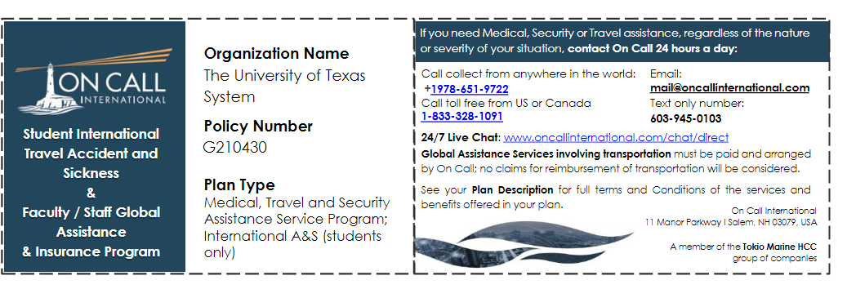
ON CALL INTERNATIONAL
On Call International is a 24/7 emergency assistance provider with an international network of medical and security professionals available any time to assist you. They can offer advice, connect you with resources, and work with you to make sure you receive the care and support you need both before and during your international travel. The first step for any incident overseas related to University-sponsored educational or business travel is to call On Call International on the UT-Dedicated Line at +1-978-651-9722.

Slide 3
Financial Literacy
﻿Some students report over-spending in the first few days/weeks of the program creating a situation where they have little money left for the remainder of the trip. Here are some good practices to keep you from over-spending. Students should:
Review cost of living in your destination.
Make a weekly or monthly budget and stick to it.
Cook your meals at home if you can rather than eating out.
Eating lunch at a restaurant can be cheaper than the dinner menu.
Consider small and inexpensive souvenirs such as postcards to let people know that you are thinking of them. Large items can be expensive to ship and cause you extra fees if you exceed the baggage weight limit when flying home.

Slide 4
Diversity Abroad
Read and learn about the local culture and social norms to better understand the local environment. Understand that different countries may be more or less conservative than the US. Do some research before your program to avoid unpleasant findings while in-country. The Department of State has put together a useful guide for all countries that will help students identify differences between the US and where they are going.
Gender: gender roles, perceptions, and protections for women and transgender students will vary greatly from one country to another.
LGBTQ+: some countries will have strong LGBTQ+ communities with a high level of tolerance or acceptance, but other countries do not protect individuals from discrimination based on sexual orientation or even categorically forbid LGBTQ+ relationships.
Religion: some countries do not allow for all religious practices.

Slide 5
What to Pack?
Pack light and pack only what you can carry.
Read airline regulations.
Make sure you have a luggage tag.
Leave space for items you'll buy there.
You may need an adaptor to fit plugs and convert electric voltage.
Don't take items of high value.

Slide 6
What to Have in Your Carry-On Bag (Not checked Bag):
Pair of underwear, essential toiletries (3.4 ounces or 100 mill or less) and a pen.
Medications – Prescription and over the counter. If you have any questions about taking and/or getting medications abroad contact On Call.
Mini first aid kit.
Passport, acceptance letter, photocopies of your passport.
Electronic devices (laptop, iPad, e-readers, etc.).
Light snacks, such as granola bars.
Address information of where you are staying.

Slide 7
Clothing
Research what kind of clothing is culturally acceptable in the country you are visiting.
Pack practical and comfortable clothing.
Consider the weather and what activities you will be doing while abroad and pack appropriately.
Find out if you will be able to do laundry on location.
Pack comfortable shoes that will allow you to do a lot of walking.

Slide 8
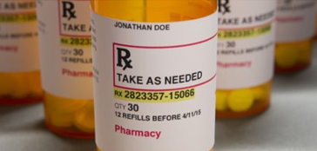
Your Health
Discuss your health and prescription needs with your doctor.
Contact On Call about entry restrictions for your prescription and your ability to access your prescription abroad.
Prescription medications must have your name on them. A physician's note is a good idea.
Hand carry at all times.
Bring enough to have while in country or plan for how to get refills.You might even want to take a prescription with you in case you lose your medication.

Slide 9
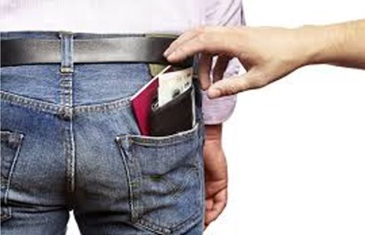
Protect Your Passport
Keep it in a safe location
— Once on location, discuss the safest location to store passport with your program leader.
— If you take it with you, keep in a zipped up bag or a hidden pouch under your clothes.

Slide 10

Call your Embassy/Consulate
Know the phone number of your embassy or consulate.
If you lose your passport:
Call and ask for Citizen Services.
  If you are an international student, you would contact the embassy of the country that issued your passport.
  If you are an international student, contact International Student Services to reissue your student visa.
Request an emergency passport.

Slide 11

What does the U.S. Embassy or Consulate do?
Emergency Resources
— Lost and Stolen Passports
— Medical Emergencies
— Victims of Crime
— Arrest and Detention
— Missing Persons and Contacting
Loved Ones
— Death Abroad
— Natural Disasters
Know your consular officer
— Ask for contact information before you leave the U.S.
— Keep that phone number on you at all times.

Slide 12

Plan Ahead
Don’t take large amounts of cash. Use credit or debit cards.
Inform your bank in advance of travel so they don’t cancel your credit or debit cards due to unusual activity.
Contact your phone company. They can advise on what you need to do to use your phone abroad.
Make copies of important documents

Slide 13
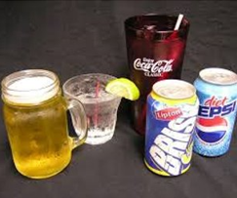
Safety
Be wary of strangers. Don’t be hesitant to tell people you don’t know to leave you alone.
Don’t put important personal belongings in back pockets or back packs. Have a bag that zips up and is close to your body.
Travel in groups with friends.
Do not use alcohol or drugs.

Slide 14
Do not break the law
Know the laws, rules, and regulations of countries that you are visiting.
The U.S Constitution DOES NOT APPLY overseas
Being a citizen of another country doesn’t exempt you from following the law in-country.
Privacy
Some countries monitor the internet.
Information you send out may be intercepted.

Slide 15
Send us pictures! We love to see what you’re up to!
Education.abroad@utrgv.edu

Slide 16
Share your experiences with UTRGV Social Media
Also send pictures for UTRGV social media:
https://forms.gle/YqxUy8JpQcGZGCm77

Slide 17
Stay in touch! Please also share this information with your parents/families. If they have any questions or concerns, they can reach out to us.
Office of Education Abroad
Caroline.miles@utrgv.edu
Education.abroad@utrgv.edu
956 665 2676
956 457 3083
If nobody answers, please leave a message and we will call you back.
After Hours Emergencies: Contact UTRGV PD Department and they will transfer the call to a staff member.
Contact Phone Numbers:
UTRGV Police Directory: (956) 882-7777
UTRGV Campus Emergency: (956) 882-4911
Emergency: 911
Email: police@utrgv.edu

