Slide 1
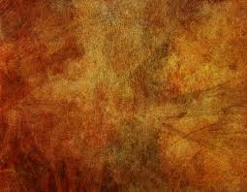
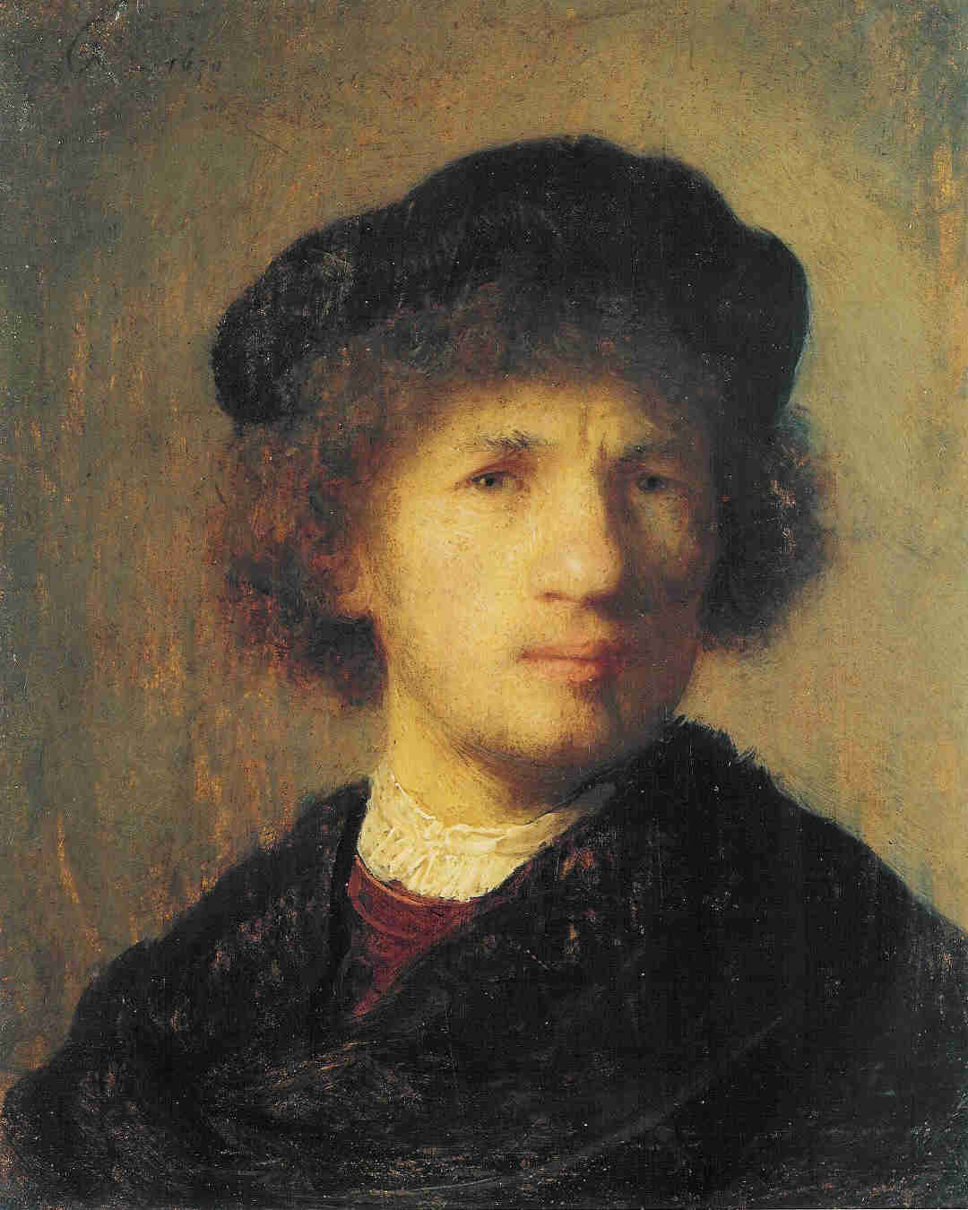
Rembrandt van Rijn
July 15, 1606- October 4, 1669
Morgan Self
Shelby Maggart
Chacity Cooper

Slide 2
What is baroque?
Barocco, meaning “irregularly-shaped pearl”
Developed during the 17th century following the Renaissance and Reformation
Left behind the idealized figures of Greco-Roman Art

Slide 3
Who is Rembrandt van Rijn?
Born 15 July 1606 in Leiden, Dutch Republic
Born in the time of the Dutch Reformation including the adoption of Calvinist theology
Attended Latin school at the University of Leiden then at the 15, he studied under the artist Jacob Issacsz Swanenburg
Later apprenticed under Dutch artist Pieter Lastman
Opened his own studio in the mid-1620s with Jan Lievens
Took on a few students such as the Dutch artist Gerrit Dou
1629, discovered by Huygens and later commissioned by the Court of the Hague
Later moved to Amsterdam and joined the Amsterdam Painters Guild

Slide 4
The Anatomy Lesson of Dr. Nicolaes Tulp (1632)
Not a new concept, but innovative style
Everyone is not symmetric with the other
Appear engaged with the lesson
Use of tenebrisim to create lively characters
Believed to contain a religious theme

Slide 5
The Night Watch(1642)
Original name Other Militimen from Amesterdam’s Second Deistrict, led by Captain Frans Banning Coq and Lieutenant Willem van Ruytenburch
Years of dirt and grime made it appear almost like a nocturnal scene
Several attacks over the years have occurred mainly with knifes

Slide 6
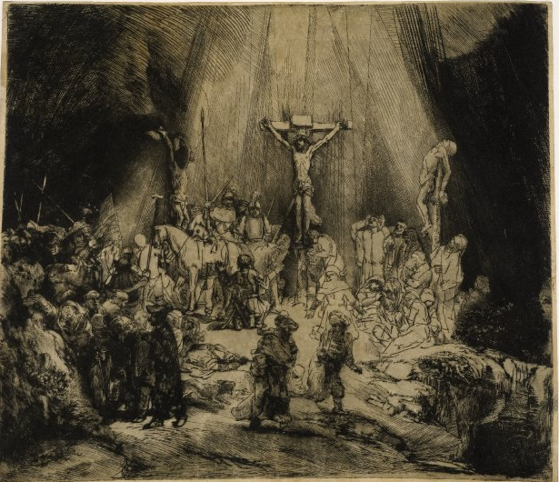
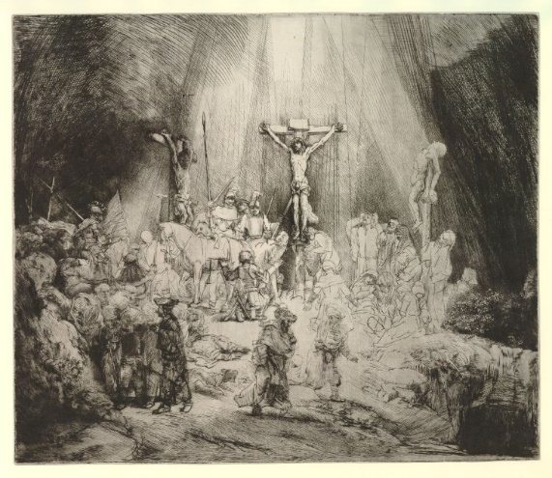
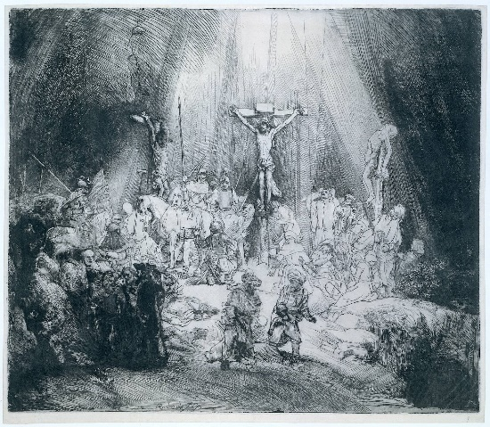
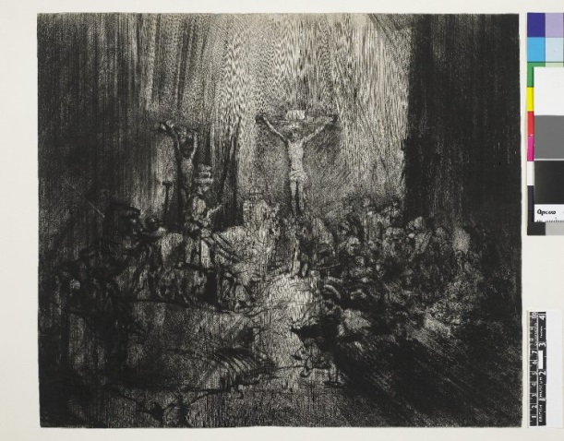
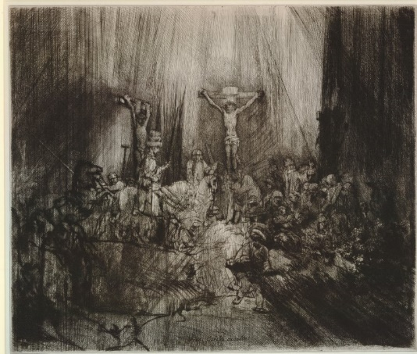
The Three Crosses
Began etchings in 1627
Depicted the death of Christ
Series of five
Extreme use of chiaroscuro
Considered a pioneer in the popularization of etching

Slide 7
Downfall of Rembrandt
Married with four children
Believed Night Watch led to his downfall
Others believed it was due to his lifestyle
After the death of his wife, he father a child out of wedlock, claimed bankruptcy was kicked out of the painter’s guild
Died a poor man, unable to receive commissions having fallen out of popularity

