Slide 1
Pablo Picasso
By: Scott mayberry, Gregory brookhart, and eyuel molla

Slide 2
Early life
Born October 25th, 1881
full name is Pablo Diego José Francisco de Paula Juan Nepomuceno María de los Remedios Cipriano de la Santísima Trinidad Martyr Patricio Clito Ruíz y Picasso
Born in Malaga, Spain
Moved to Barcelona, spain, at 14 years old

Slide 3
Early artistic ability
His father was an artist
Pablo started painting at a young age
Enrolled in the school of fine arts in Barcelona
After he moved to Madrid and enrolled in the royal academy of san fernando

Slide 4
The rebel
He did not like learning from the classics
Would create his own versions of standard paintings
Did not pay attention in school
Was not very political, tried to stay out of politics

Slide 5
Blue period
Lasted FROM 1901 TO 1904
The cause was a friends suicide. His name was Carlos casagemas
Featured different hues of blue and green
Often features poverty, loneliness, any form of sadness

Slide 6
Famous blue period paintings
The old guitarist
Couple in a café

Slide 7
Rose period
Transitioned from blue period
Started in 1904 and went to 1906
Found a new lover, fernande Olivier,
Gained a new patron, Gertrude stein
Featured harlequins and the lighter side of life, love and happiness

Slide 8
Famous Rose period paintings
The Family of acrobats with a monkey
Maternity

Slide 9
Cubism

Slide 10
Negro period
lasted from 1906 to 1909
Negro period, or black period is the proto-cubist period
Follows the blue and rose period

Slide 11
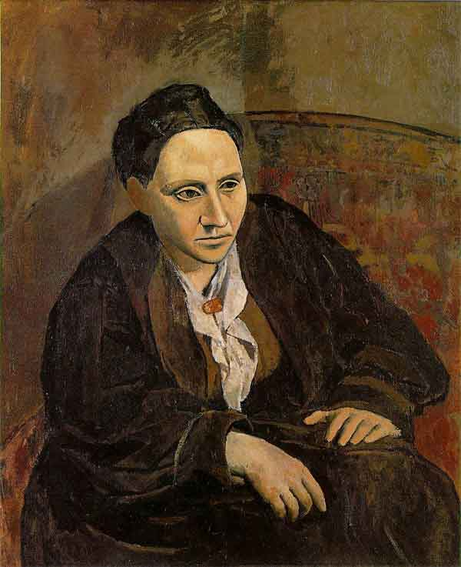
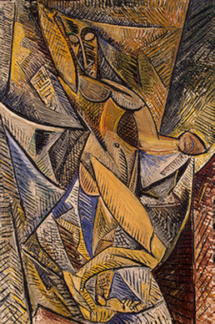
Some art work of the negro period
Notes:
Gertrude Stein 1906, Spring 1907 Dance of the Veils, Les Demoiselles d'Avignon, 1907

Slide 12
Analytical Cubism
1908-1911, by Picasso and Georges Braque
characterized by monochrome, relatively unemotional paintings that depict rather uneventful subjects, such as still lives.
Many paintings of analytical cubism are faceted
dissect and reconstruct his subject in a way that depicts its essence rather than its appearance
1911 start seeing juan Gris, their pupil

Slide 13
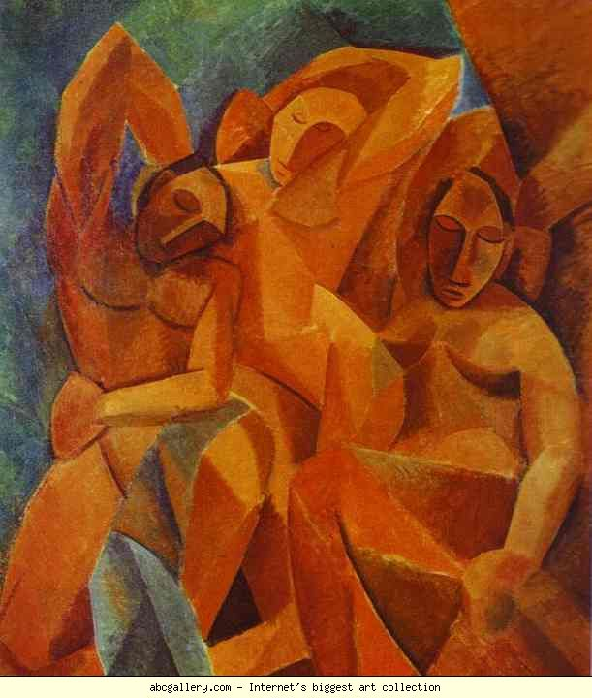
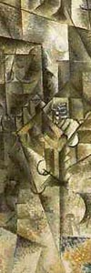
Some of Analytical Period Art
Notes:
Bread and Fruit 1909, Three Women. 1908, Accordionist, 1911

Slide 14
synthetic cubism
1912-1919
the late phase of cubism
characterized chiefly by an increased use of color and the imitation or introduction of a wide range of textures and material into painting.

Slide 15
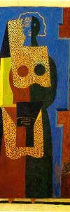
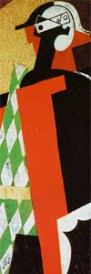
Some of the synthetic period paintings
Notes:
Le Egyptien 1916, guitar, clarinette et bouteille sur une table, 1916; arlequin 1916

Slide 16
Classicism period
The period 1916 to 1924
An approach to aesthetics that favors restraint, rationality, and the use of strict forms in literature, painting, architecture, and other arts. It flourished in ancient Greece and Rome, and throughout Europe in the seventeenth and eighteenth centuries.

Slide 17
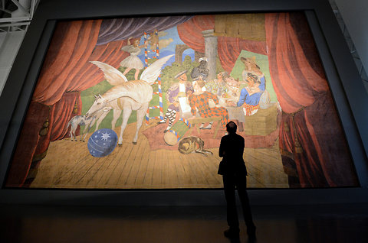
Paintings of Classicism
Notes:
La Danse Villageoise. 1922, Ballet “Parade” 1917

Slide 18
Surrealism Period
1925–1935
a 20th-century avant-garde movement in art and literature that sought to release the creative potential of the unconscious mind, for example by the irrational juxtaposition of images.
In 1937, Guernica was created as a depiction of the bombing of guerinica

Slide 19
Most famous surrealism painting ever
Notes:
Guernica, 1937

Slide 20
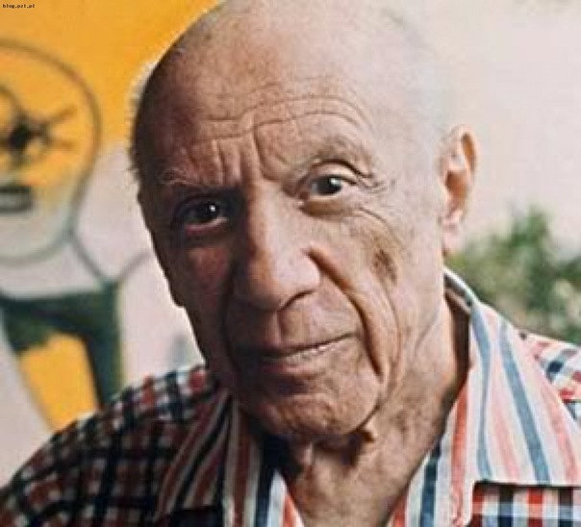
The influence of Pablo Picasso
Pablo Picasso
Influenced the rise of modern art
Picasso’s artworks have impacted generations of artists across the world.
Picasso’s approach towards art has been replicated and introduced in many aspects of modern art.

Slide 21
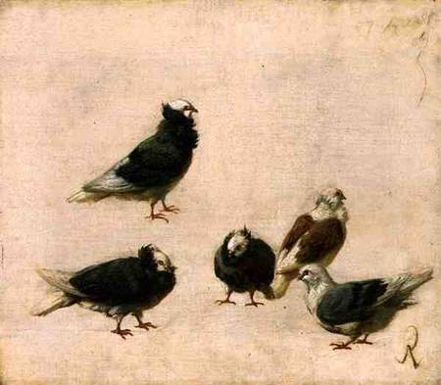
A painting of pigeons by Don Jose Ruiz y Blasco
Don Jose Ruiz y Blasco (father of Pablo Picasso)

Slide 22
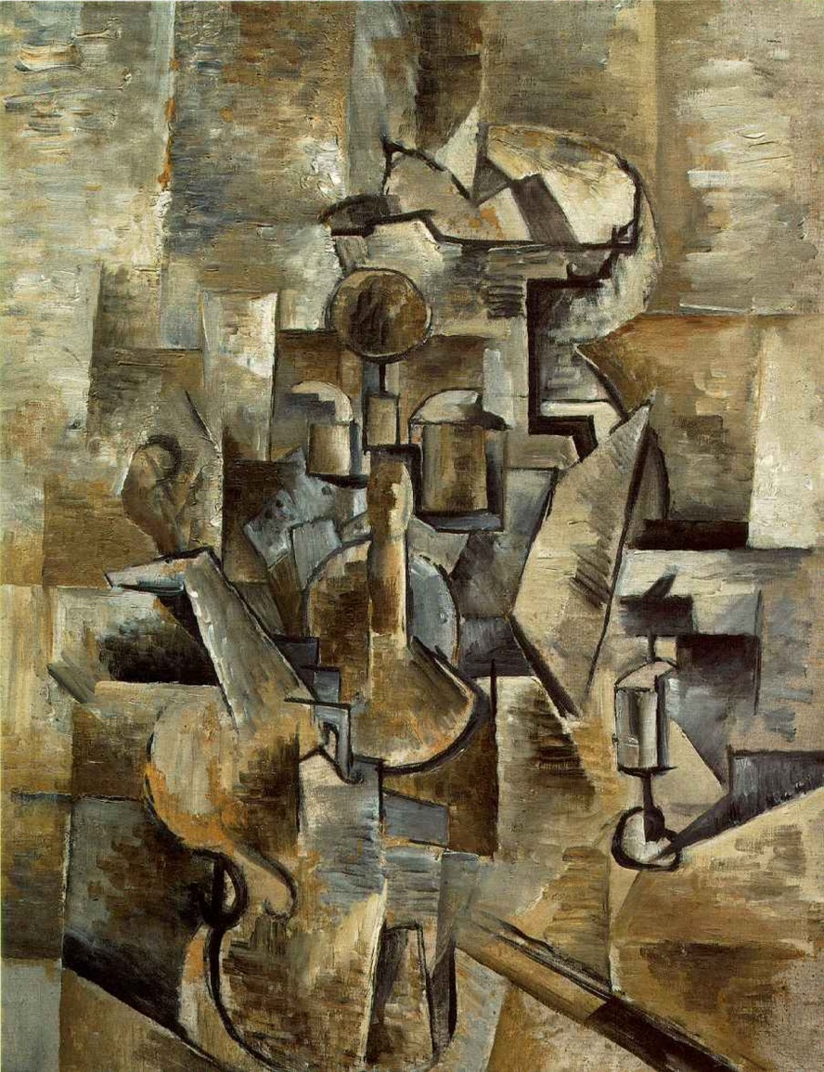
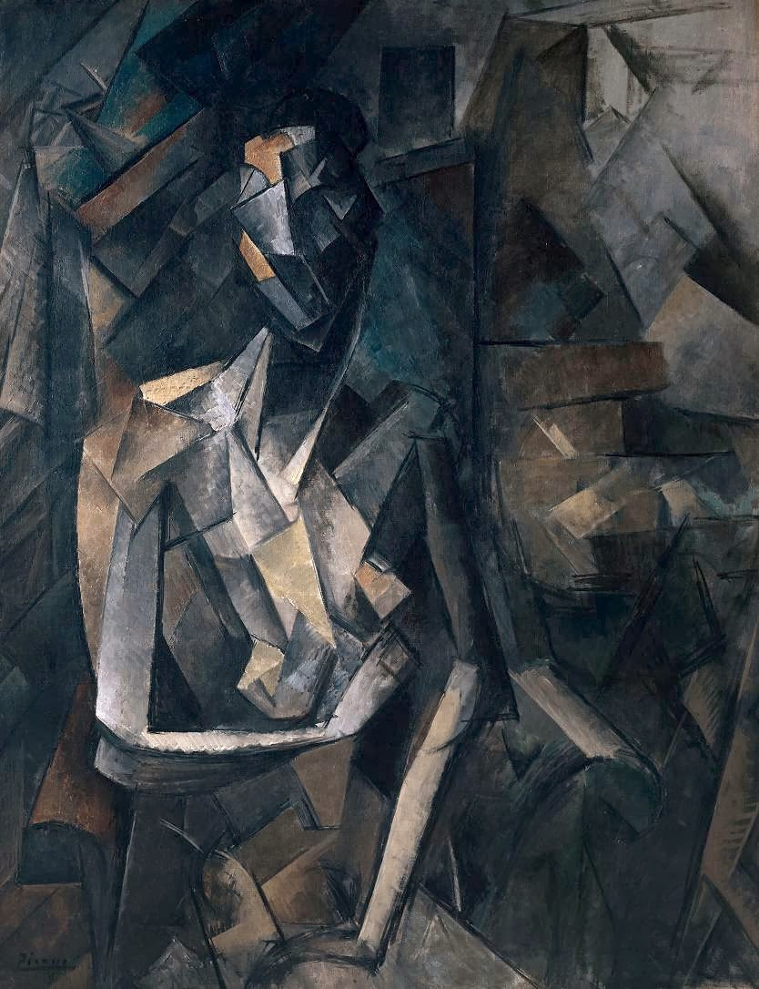
Cubism
Violin and Candlestick
(Georges Braque 1910)
Figure dans un Fauteuil
(Pablo Picasso 1909)

Slide 23
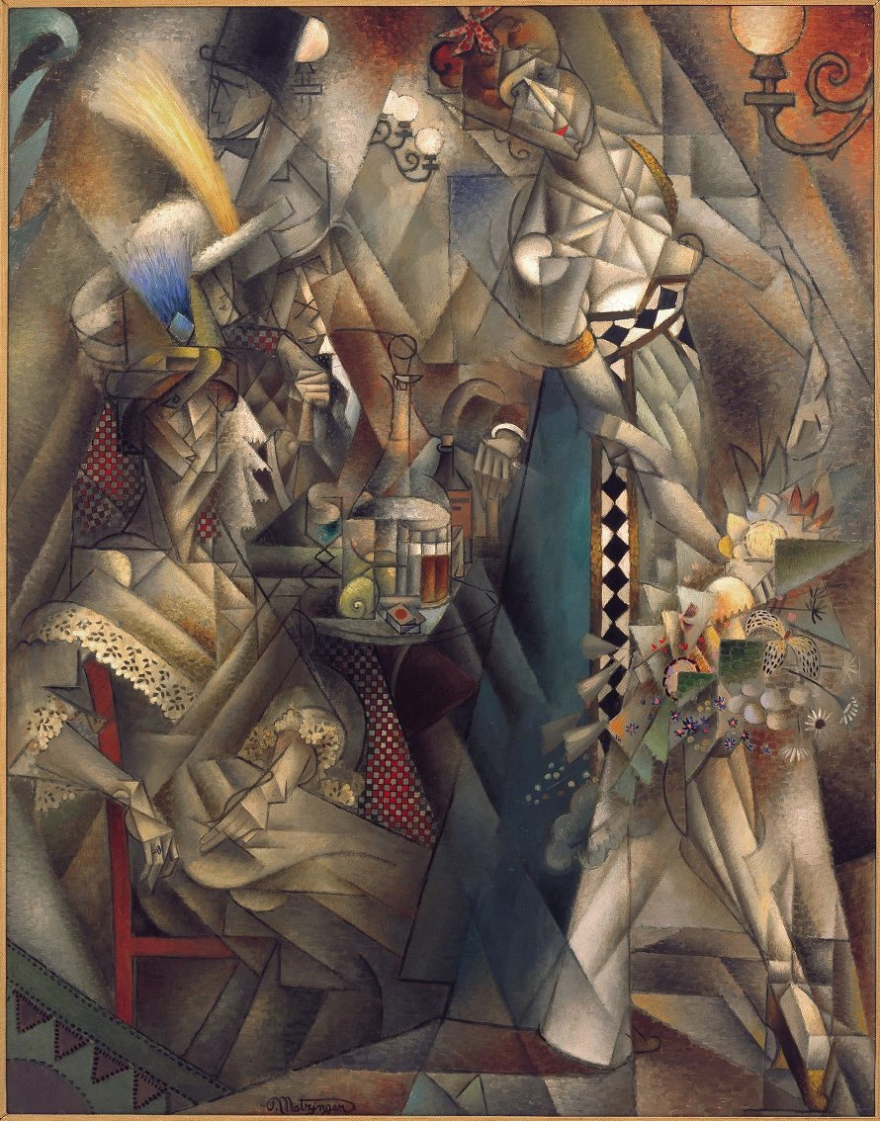
Danseuse au café
(Metzinger, Jean 1912)

Slide 24
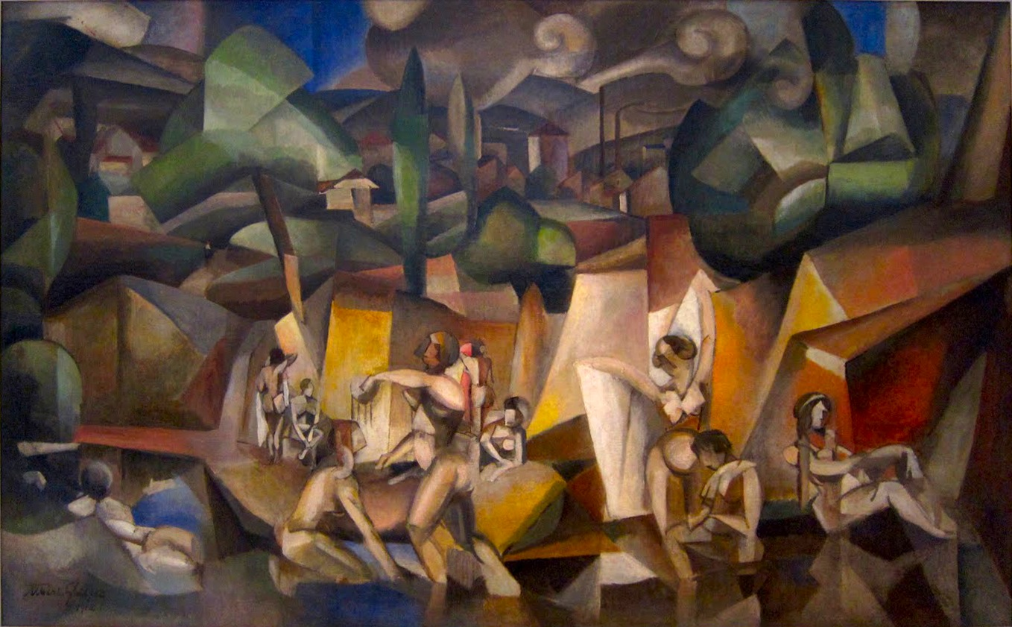
Les Baigneuses
(Albert Gleizes 1912)

Slide 25
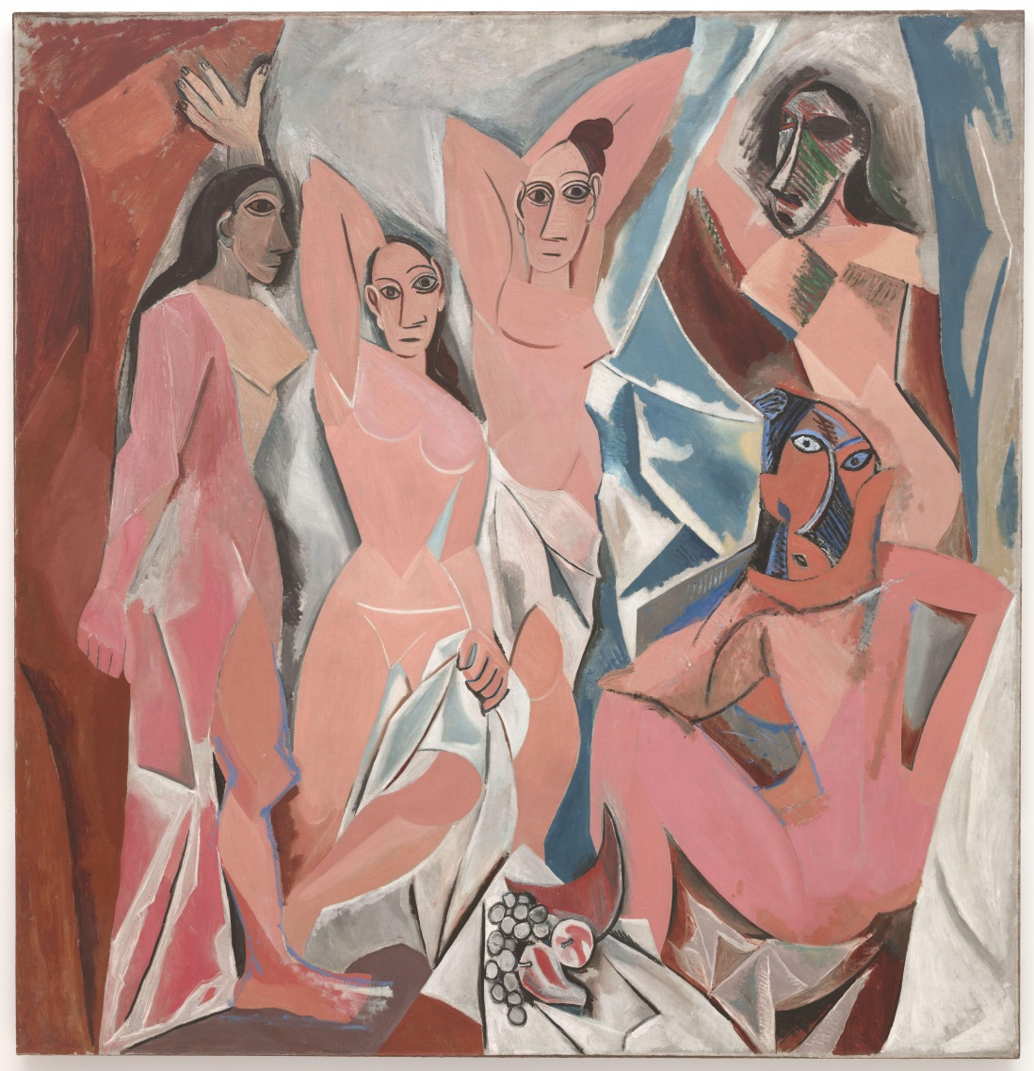
Les Demoiselles d'Avignon (Pablo Picasso 1907)
Les Demoiselles d'Avignon adopted an early form of Cubism.
Les Demoiselles d'Avignon is an oil painting based on prostitutes from a brothel in Carrer d'Avinyó (Avinyó Street).
Picasso had originally referred to this painting by the name mon bordel (my brothel) or Le Bordel d'Avignon, meaning “The Brothel of Avignon”.
It was later renamed to Les Demoiselles d'Avignon

Slide 26
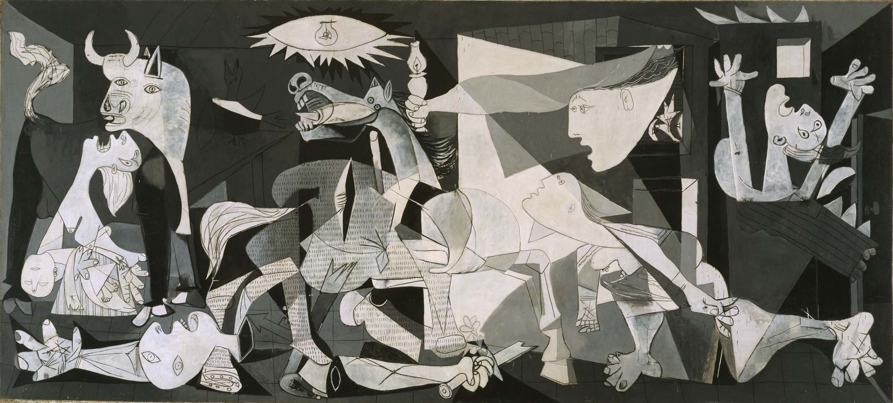
Pablo Picasso drew Guernica as a response to the Nazi Germany’s devastating bombing of Basque, Guernica during the Spanish Civil war.
Guernica
(Pablo Picasso 1937)

Slide 27
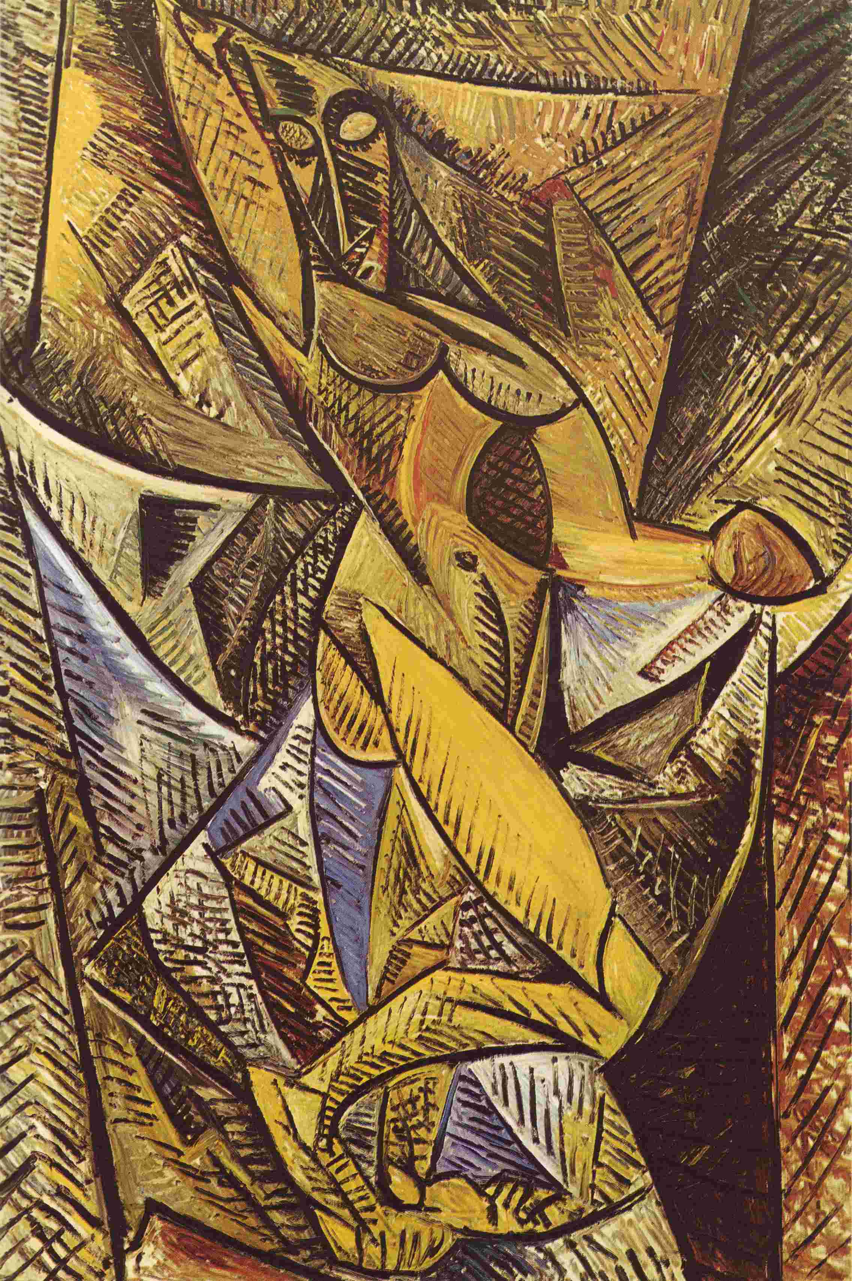
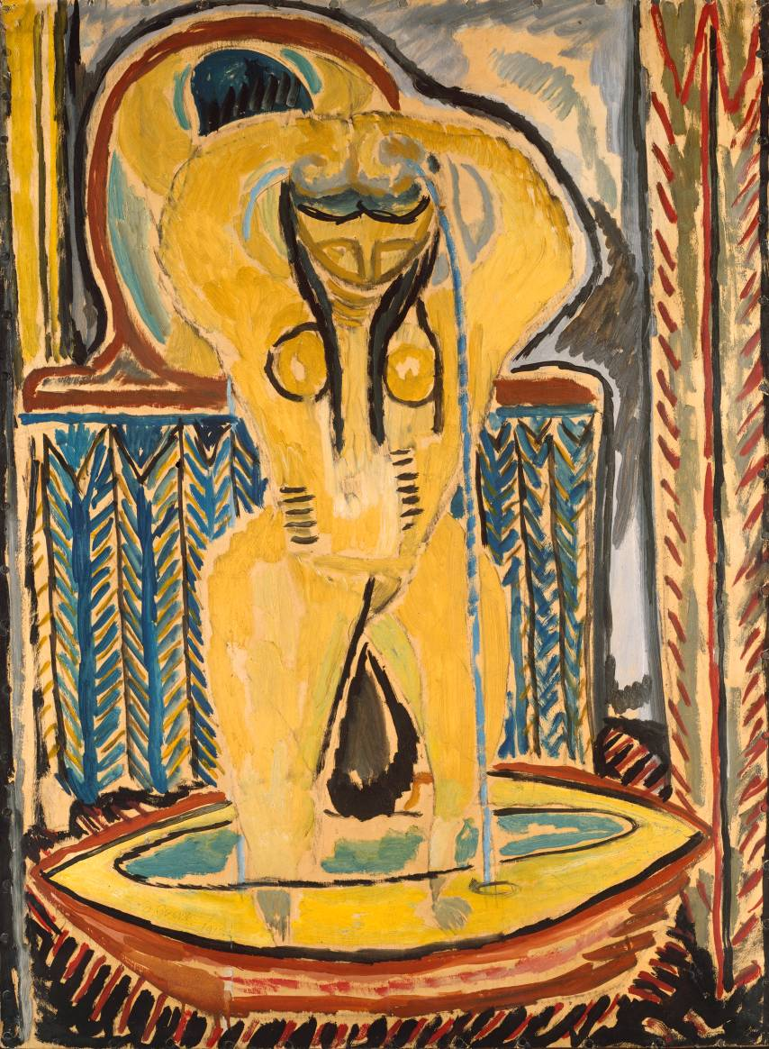
Nude with Drapery
(Pablo Picasso 1907)
The Tube
(Duncan Grant 1913)

Slide 28
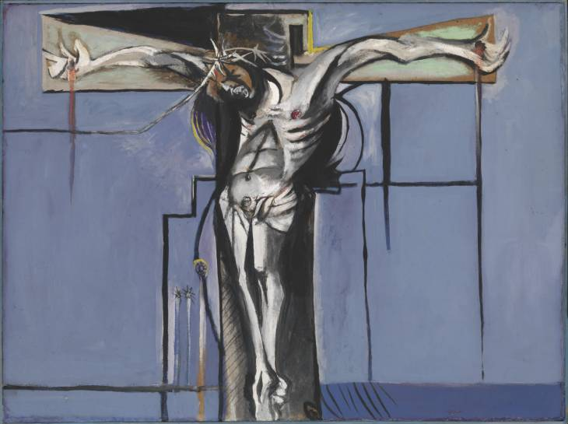
Crucifixion
(Graham Sutherland 1946)

Slide 29
“I paint objects as I think them, not as I see them” – Pablo Picasso

Slide 30
Works Cited
Chevalier, Denys. Picasso: The Blue and Rose Periods. New York: Crown, 1969. Print.
Gedo, Mary Mathews. Picasso, Art as Autobiography. Chicago: U of Chicago, 1980. Print.
Handa, Carolyn. "11." Visual Rhetoric in a Digital World: A Critical Sourcebook. Boston: Bedford/St. Martins, 2004. N. pag. Print.
"Pablo Picasso." Bio.com. A&E Networks Television, n.d. Web. 10 Apr. 2014.
Pablo Picasso: The Power of Art. Life And Discovery, n.d. DVD.
Solomon, Barbara P. "Collow Young Genious." New York Magazine (n.d.): 83. Web.
Galenson, David W.; Weinberg, Bruce A. “Creating Modern Art: The Changing Careers of Painters in France from Impressionism to Cubism”
On-line Picasso Project. Selfridge, John. 1994. picasso.shsu.edu.
.Oxford University Press. 2009. Moma.org.
The Private Life of a Masterpiece. bbc.com. Video.
McKay, Cory. Historical Influences of Picasso’s Les Demoiselles d’Avignon. McGill University. Web.
Tate Museum. Picasso & Modern British Art, Picasso & Duncan Grant. tate.org.uk. Web.
Tate Museum. Duncan Grant. tate.org.uk. Web.
UNED. 30 anos del “Guernica” en Espana. Uned.es. Web.
Penrose, Roland, and John Golding. Pablo Picasso, 1881-1973. New York: Portland House, 1988. Print.
Bibliography
LastName, First, Middle. "Article Title." Journal Title (Year): Pages From - To. Print.
Shabi, K. Guernica Meaning: Analysis & Interpretation of Painting by Pablo Picasso. 31 July 2013. <http://legomenon.com/guernica-meaning-analysis-of-painting-by-pablo-picasso.html>.
The timeline of Cubism. n.d. <http://www.cubistro.com/cubotimeline.html>.

