Slide 1
How to draw a Reclining Nude With Pastel Chalks For this Soft Pastel Drawing, use pastel paper, in a warm grey color.

Slide 2
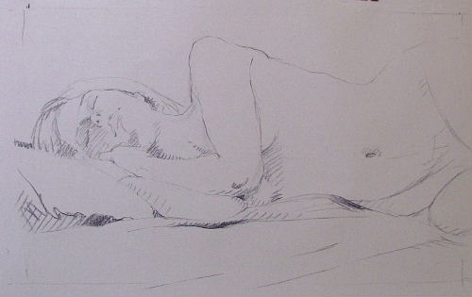
Start with a vine charcoal drawing.... the vine charcoal can be manipulated easily and can be wiped off if you want to adjust the drawing.

Slide 3
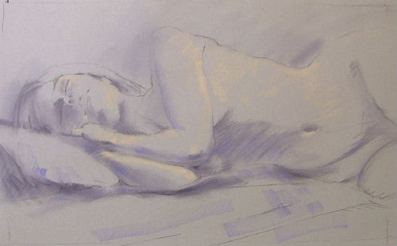
Add some mid-tones/values, using a deep purple..... You want to just color the paper at this stage and to mark where the accents will be.... bones beneath the skin, the darkest shadows, etc.

Slide 4
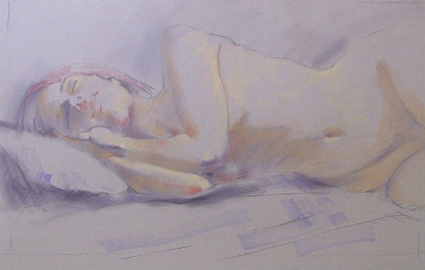
In this step you are beginning to establish highlights on the figure (finding where the light falls on her body from the one light source). All those planes must be facing the light to create the correct illusion.

Slide 5
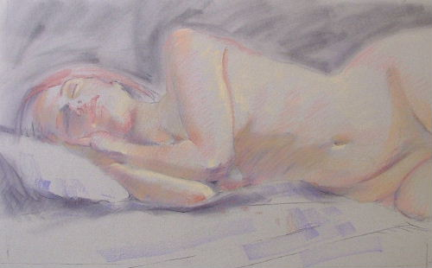
Still working loosely, apply a couple of skin tones over the purple to begin warming up the shadows.

Slide 6
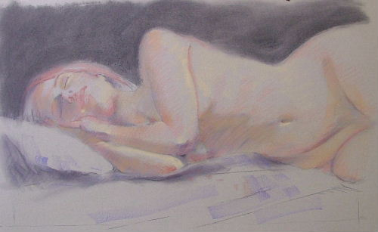
Locate what are sometimes called 'hot spots'....where you see the warmest of the skin colors.... in the creases, on the elbows, lips, cheeks, etc. Nothing is set in concrete at this stage.

Slide 7
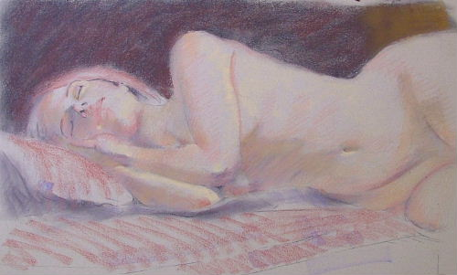
For this drawing, make the background dark. Think about how you will bring color into the background. Consider how you will carry the added color through the drawing.

Slide 8
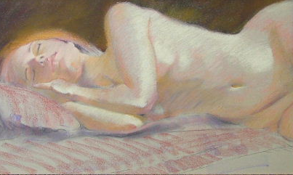
Let the foreground color be reflected onto the skin, and let the skin color be reflected onto the sheets. This will help unify the whole drawing.

Slide 9
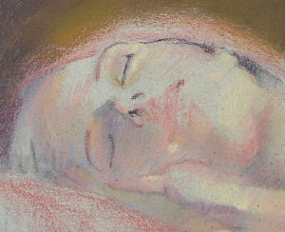
Close up of the model's face at this stage.

Slide 10
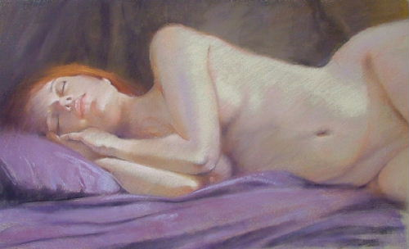
Finish off the skin tones using some variations of pink and lighten the highlights. Add the purple sheets, and add reflected purples and blues from the sheets to the background.

Slide 11
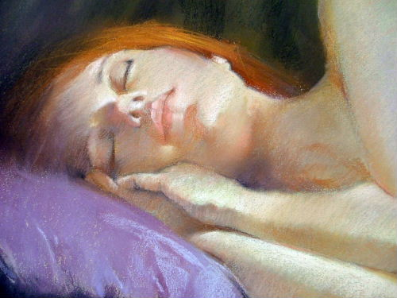
Add the final details to the drawing. Use the lightest colors in your chosen palette to bring the skin tones to life.

Slide 12
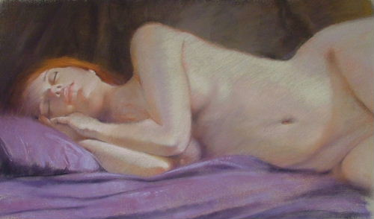
The finished drawing should look something like this.

