Slide 1
Drawing II – Figure Drawing
Composing without cropping with the edge and selective completion as a means of composing

Slide 2
Alternative Ways to Compose
Generally, most figure studies either include the entire figure with minimal activity in the ground, or…
The edge crops the figure for its abstract potential

Slide 3
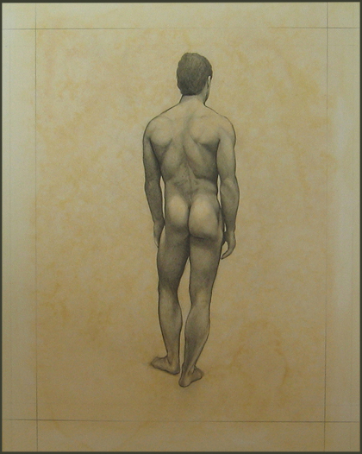

Slide 4
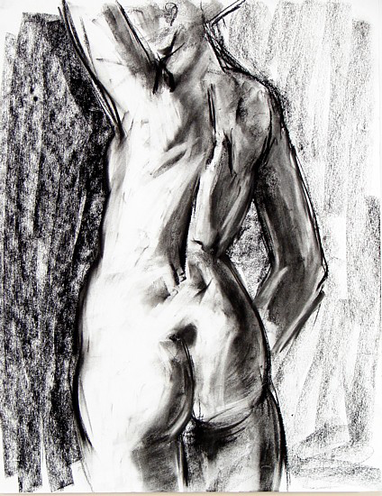

Slide 5
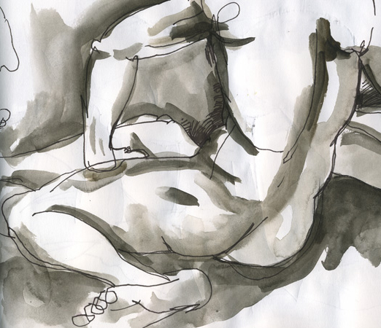

Slide 6
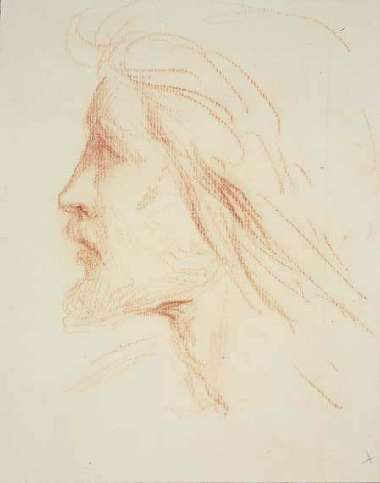
Composing Without Cropping with the Edge of the Rectangle

Slide 7
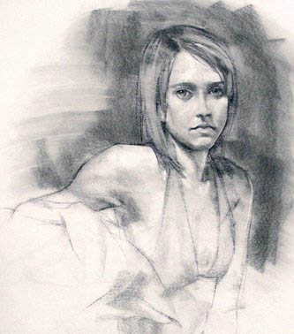

Slide 8
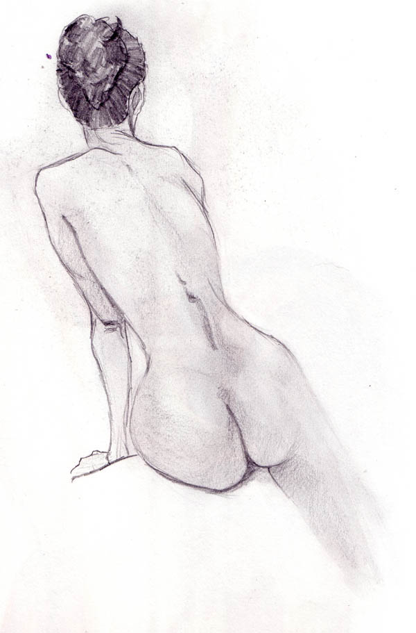

Slide 9
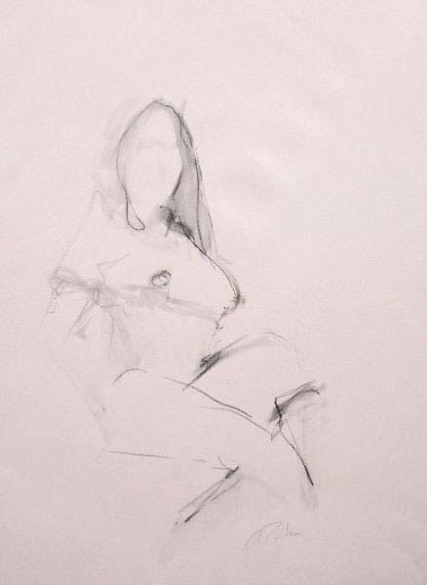

Slide 10
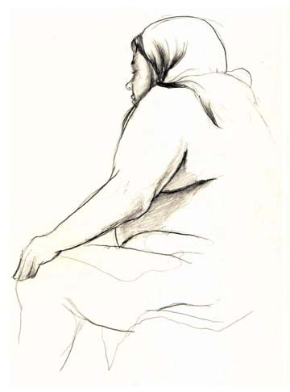

Slide 11
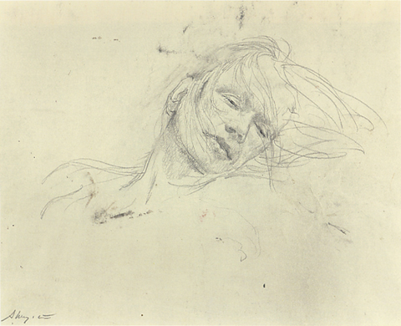

Slide 12
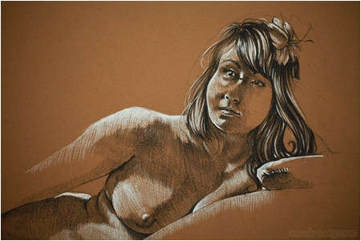

Slide 13
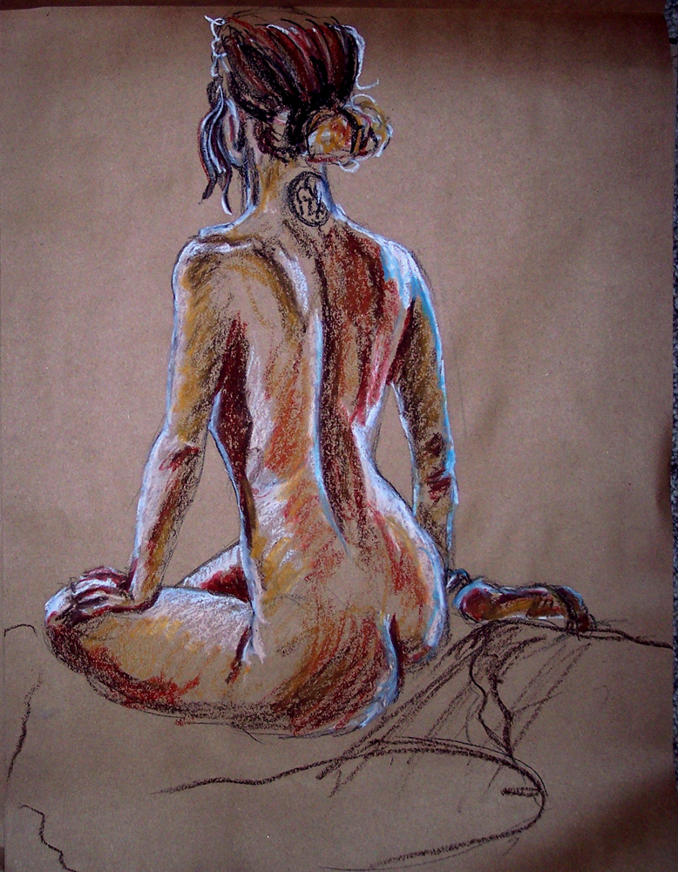

Slide 14
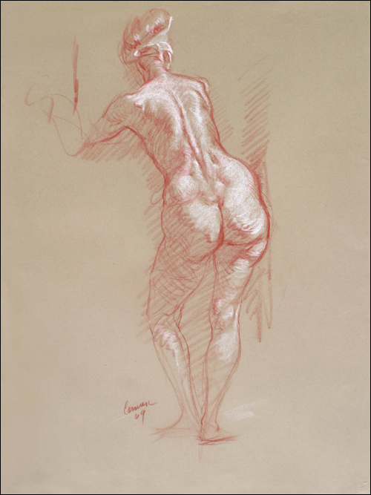

Slide 15
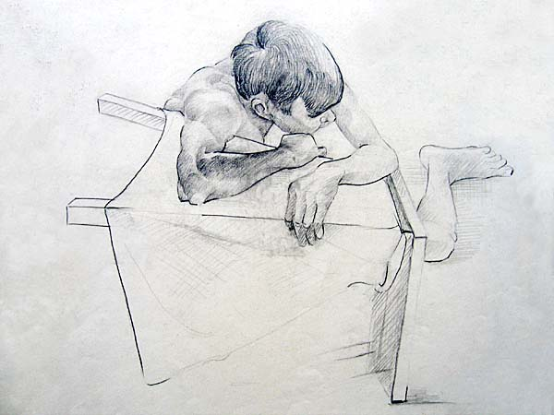

Slide 16
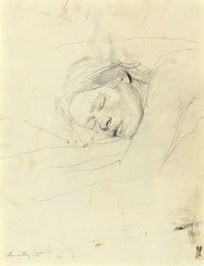

Slide 17
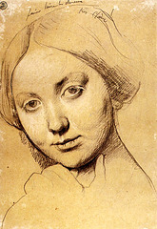

Slide 18
