Slide 1

Notes:
Share why you’re presenting today and your affiliation with the program (briefly)
The Gilman Scholarship is sponsored by the Bureau of Educational & Cultural Affairs at the U.S. Department of State and has been administered by the Institute of International Education (IIE) since the program’s inception in 2001.
The Gilman Scholarship Program has become the largest U.S. undergraduate scholarship program supporting U.S. students of high financial need to participate in study abroad programs and international internships.
Gilman is one of many vehicles to help students go abroad through scholarships; however it is much more than just money or a program – it is the access to a life-changing experience, to an opportunity to give back to students like you, and to become a part of a legacy that will continue to give back to you.

Slide 2

Notes:
The Gilman Scholarship is sponsored by the Bureau of Educational & Cultural Affairs, or ECA, in the U.S. Department of State.
ECA leads a wide range of academic, professional, and cultural exchanges that include approximately 40,000 participants annually, with the goal of increasing mutual understanding and respect between the people of the United States and the people of other countries.
ECA’s goal is to promote mutual understanding between the people of the United States and the people of other countries, and they do so by facilitating opportunities of academic, professional, athletic, and other cultural exchange.
The Gilman Scholarship is just one of the many programs sponsored by the ECA, and Gilman Scholars become a part of a network of approximately 40,000 people who participate in ECA programs every year.
You can learn more about ECA and the variety of opportunities they support by visiting their website: exchanges.state.gov
The Gilman Scholarship is a program within the Bureau’s Office of U.S. Study Abroad. The U.S. Study Abroad Office is committed to shaping and sustaining a more peaceful, prosperous and just world by increasing and diversifying participation in study abroad. We encourage you to visit the new USA Study Abroad website at studyabroad.state.gov and access the many resources they have available, such as travel health and safety information, student mobility data, country and regional profiles, and study abroad program information.

Slide 3
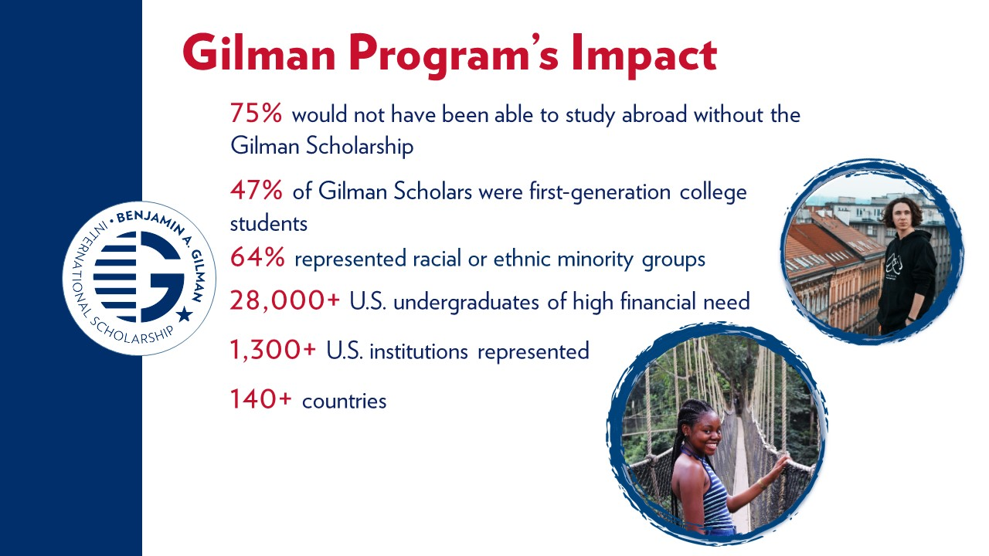
Notes:
By supporting undergraduate students who have high financial need, the program has been successful in supporting students who have been historically underrepresented in education abroad, including but not limited to first-generation college students, students in STEM fields, ethnic minority students, students with disabilities, students attending HBCUs or other minority-serving institutions, students attending community colleges, and students coming from U.S. states with less study abroad participation.
Since the program’s inception in 2001, more than 25,000 bright, ambitious, and diverse American students have received a Gilman Scholarship to study or intern in more than 140 countries and hail from more than 1,200 universities across the nation. The Gilman Program engages with public and private-sector partners to increase participation.

Slide 4
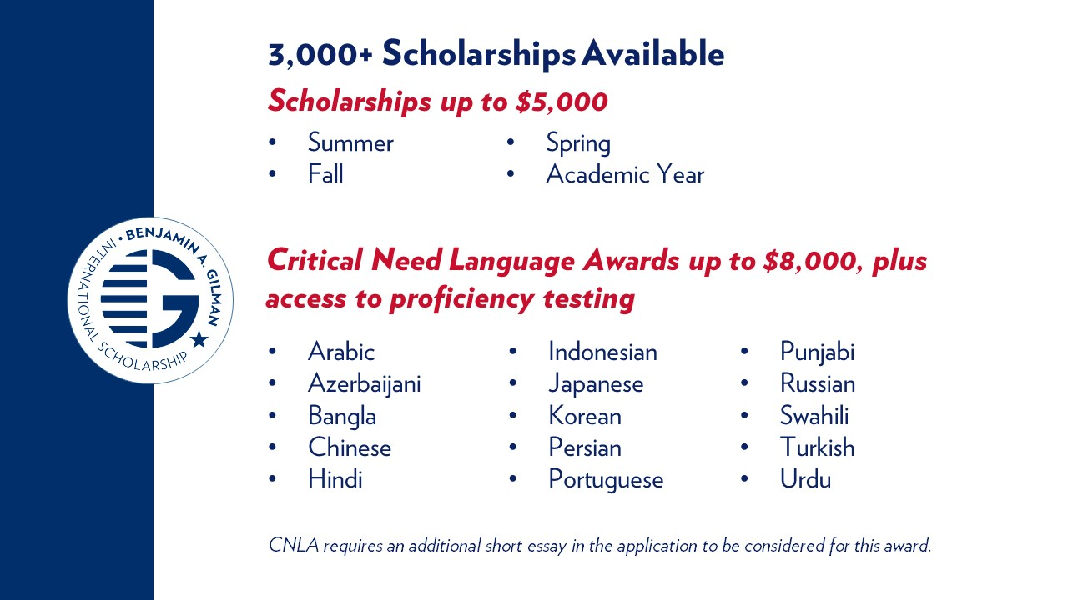
Notes:
Recipients of the scholarship can receive up to $5,000 to use towards program costs, such as tuition, fees, room/board, meals, transportation and passport and visa costs.
Award amounts will vary depending on the length of study, student need, and the selection process.
Students can apply the scholarship toward a fall, spring, summer or academic year term program.
The Gilman Program is often asked, “what are the chances of me receiving a scholarship?” Generally 1 in 4 students are awarded. Keep in mind that may fluctuate with the number of applicants and awards we have every year, but that’s a fairly consistent ratio. Which means, this is a competitive, yet attainable scholarship for many students!
If selected for a Gilman Scholarship, recipients will utilize the password protected and secure Gilman Recipient Portal to input all fund distribution information. Recipients of the Gilman Scholarship will never be contacted by phone or email to provide personal bank information.
Applicants who are studying a critical need language while abroad in a country in which the language is predominantly spoken can apply for a supplemental award of up to $3,000, for a combined total of $8,000. This award is competitive and offered to a limited number of Gilman scholars each year.
In addition to receiving additional funds for language study, students who are awarded the Critical Need Language Award and complete their Gilman Scholarship requirements will be offered the opportunity to take the ACTFL Oral Proficiency Interview (OPI). This test and the results will serve as both an evaluation measure of the award and as a credential for the award recipient.

Slide 5
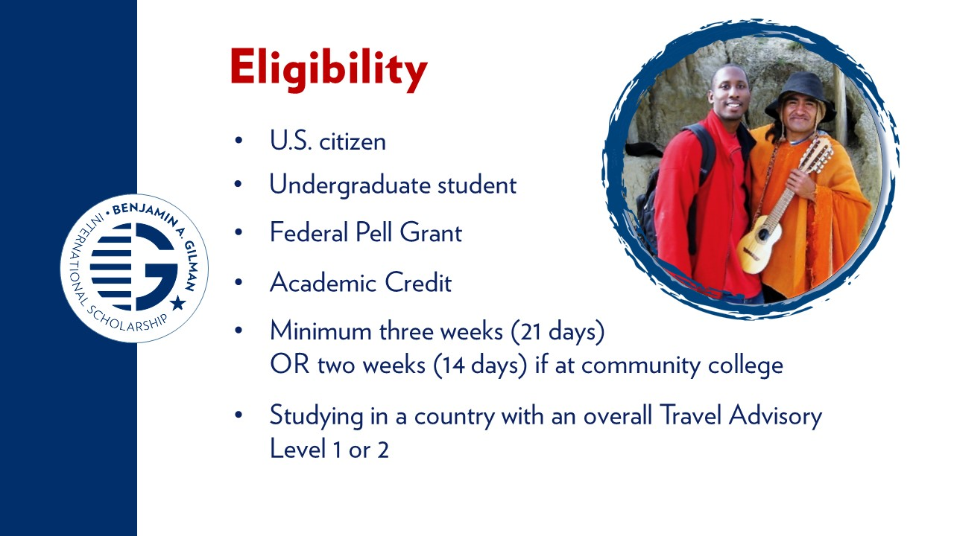
Notes:
To be eligible for a Gilman Scholarship, an applicant must:​
Be a citizen of the United States; ​
Be an undergraduate student in good standing at an accredited institution of higher education in the United States (including both two-year and four-year institutions);​
Be receiving a Federal Pell Grant or provide proof that he/she will be receiving a Pell Grant during the term of his/her study abroad program or internship;​
Be in the process of applying to, or accepted for, a study abroad or internship program of at least two weeks for community college students and three weeks for students from four-year institutions, in a single country and eligible for credit from the student's home institution. Proof of program acceptance is required prior to award disbursement;​
Be proposing to study in a country with a level 1 or 2 travel advisory from the U.S. Department of State, the full list of which is available at travel.state.gov. Certain areas within these countries may be designated within the Travel Advisory as either “Do not travel to” (Level 4) or “Reconsider travel to” (Level 3) locations, as such; students will not be allowed to travel to these areas. Students are not eligible to apply for programs in a country with an overall Level 3 or 4 Travel Advisory. Should a Travel Advisory change to a Level 3 or 4 after the student has been granted the award, the student’s scholarship status will be examined under the strict guidance of the U.S. Department of State, the directive of the updated Travel Advisory, and the recipient’s U.S. home institution. In determining a grantee’s status, the Gilman Program, under the direction of the U.S. Department of State, is the final decision making authority regarding the continuation of a student’s participation as a grantee of the Gilman Program.​
​
​
Note: Gilman Scholarship recipients can only receive the scholarship once. If a student previously declined the Gilman Scholarship, they are welcome to re-apply, as long as they still meet all eligibility requirements as listed above.

Slide 6
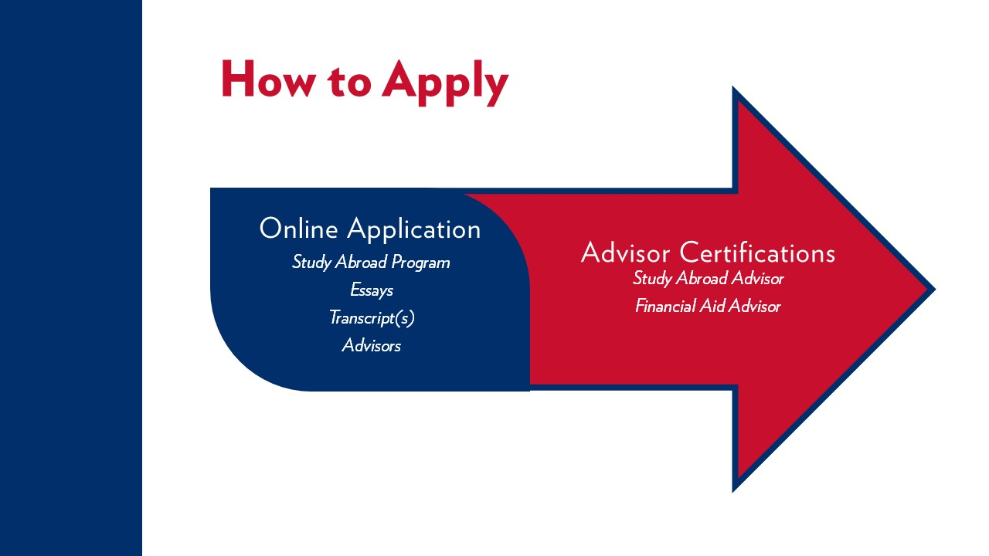
Notes:
The entire application process is conducted online. The online application asks for program details and two essays, and also requires undergraduate transcripts. The Gilman Program requires transcripts for applicants’ current institution and transcripts from any previous institutions attended. ​
​
The application also requires applicants select a study abroad advisor and a financial aid advisor within the application. Advisors can register for an account to be added to the application system by going to gilmanscholarship.org/advisors and following the directions there.

Slide 7
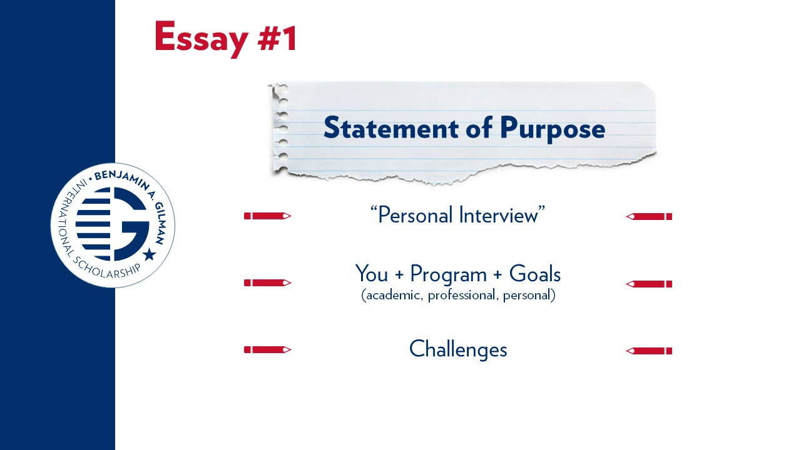
Notes:
In addition to indicating home institution, certifying advisors, and abroad program information in your Gilman application, you must submit two essays. These are essential components of your Gilman application. Each essay is a maximum of 7,000 characters, which is roughly about a page and a half. The essays are important because Selection Panelists, advisors and administrators at U.S. campuses, review these applications and this is their only way of getting to know who you are and reasons for studying abroad. In the application, the Gilman Program provides prompts for each essay – questions that you should consider answering in your essays.​
​
The Statement of Purpose essay is essentially a personal interview on paper. You should talk about the impact of study abroad on your academic goals, professional goals and personal growth, as well as how the Gilman Scholarship can help you accomplish these goals. You should also touch upon what inspired you to study abroad and what challenges you have faced in studying abroad, such as family conflict, work obligations, health or disabilities. All students applying to the Gilman Program have financial need, so you may speak of this, but elaborate on other challenges you may face in addition to that.

Slide 8
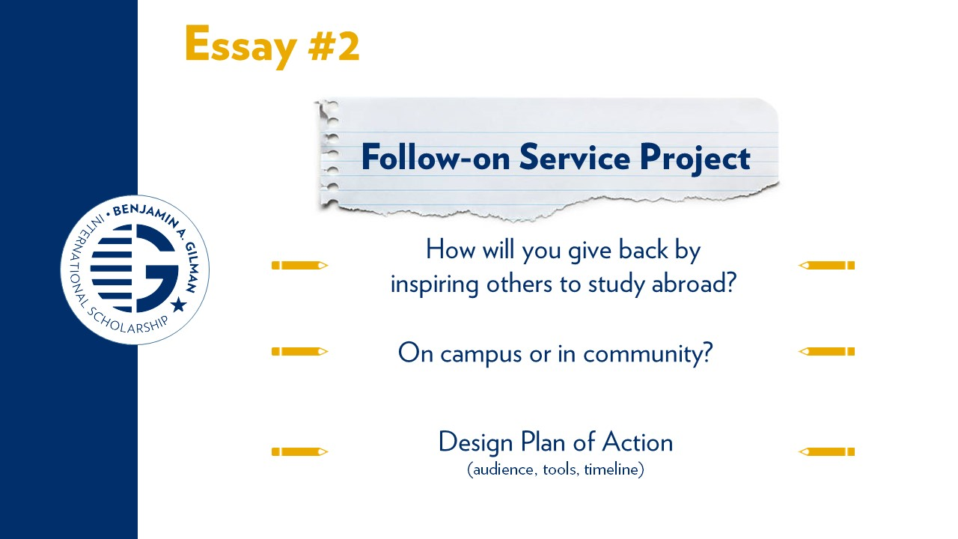
Notes:
The Gilman Program and the program sponsors at the U.S. Department of State value the multiplier effect this program can have on U.S. campuses and communities. Therefore, the Follow-on Service Project proposal essay requires you to design a project to promote the Gilman Scholarship. In this essay, students are asked to map out a potential project for them to complete upon their return to the U.S. that will encourage others to study or intern abroad and spread awareness of the Gilman Scholarship. The project can be completed on their home campus or in their local community, and it must be completed within 6 months of their return to the U.S. ​
​
Key aspects to this essay are the creativity and feasibility. The Gilman Program advises students to use activities & organizations that they are already involved in as inspiration (student clubs, academic departments) and can therefore begin discussion of their project with key contacts, even prior to being awarded the scholarship. We also ask students to consider their audience, tools and timeline when proposing a project for the Gilman Scholarship application.

Slide 9
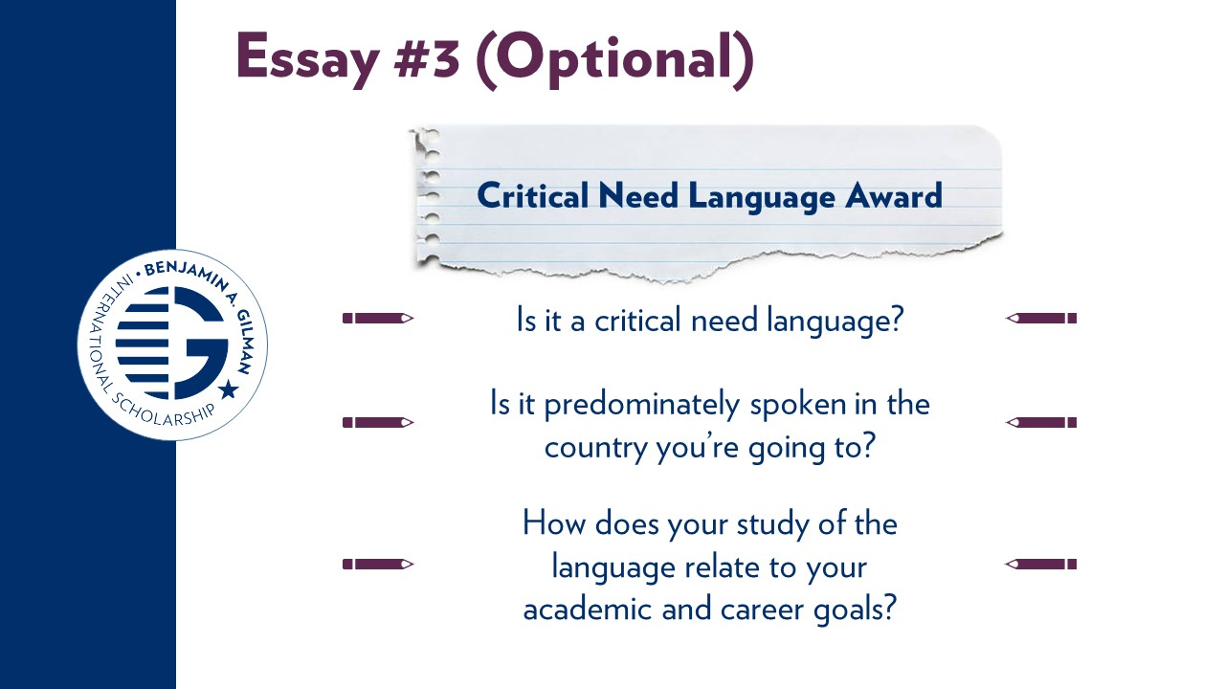
Notes:
As explained earlier, applicants who are studying a critical need language while abroad in a country in which the language is predominately spoken have the option to be considered for the Critical Need Language Award, for a total award of $8,000. This award is competitive and offered to a limited number of students each year. To be considered for the Critical Need Language Award, a brief additional essay is required and can be submitted in the same Gilman application.
Some key points to keep in mind are:​
Be sure that the language you are studying while abroad is considered a Critical Need Language by the U.S. Department of State. You can see the list of Critical Need Languages at gilmanscholarship.org. Any other language study is not eligible for the Critical Need Language Award.​
Be sure that you are studying the Critical Need Language in a country where it is predominately spoken. ​
Explain the level of intensity of your critical need language study while abroad, how studying this language will further your academic and career goals, what your motivations are for learning or improving your language proficiency, and how you intend to improve your language skills while studying abroad.

Slide 10
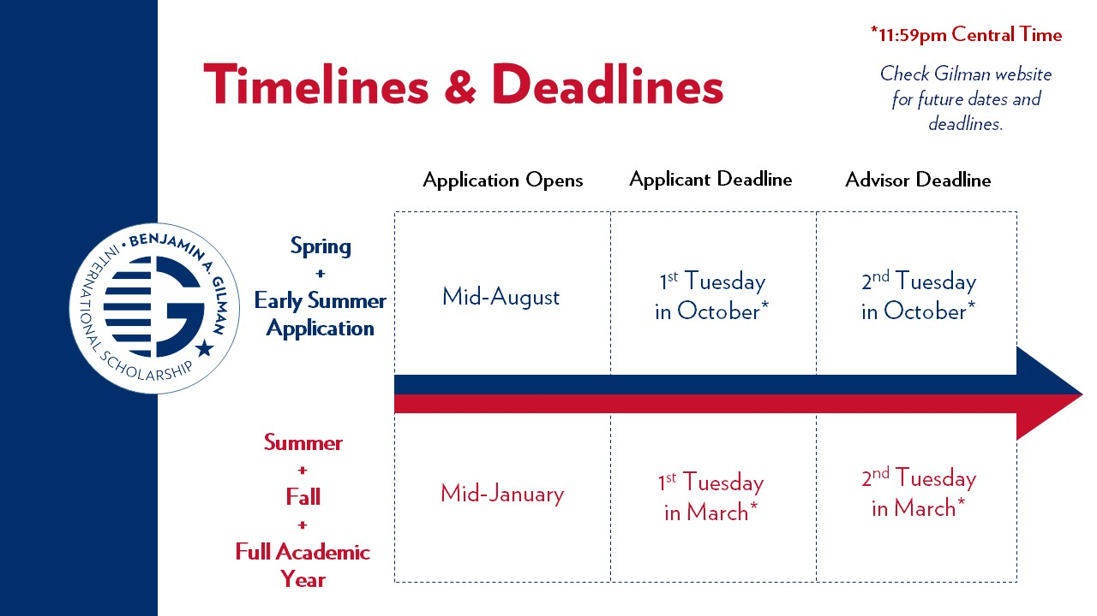
Notes:
Once you have submitted your application, it must be certified by both a study abroad and financial aid advisor. The deadline for advisor certification is one week after your deadline.
The application deadline for both Spring and Summer programs for 2019 is October 2nd, 2018. The Gilman Program offers the summer early application as an additional application cycle in an effort to support students who may already be preparing for their summer 2019 study abroad program or international internship and would like earlier notification of their status to better plan their financial commitments. If this sounds like you, this would be the application cycle for you to apply.
For those participating in programs during the summer or fall terms, or for the academic year starting in the fall, the deadline for that application cycle is in March and the application will be open in January.
Please note that the deadline is 11:59pm Central time so please keep that in mind if you are in another time zone. Late applications will not be accepted under any circumstances so we highly recommend completing your applications before the deadline in case you have any questions.

Slide 11
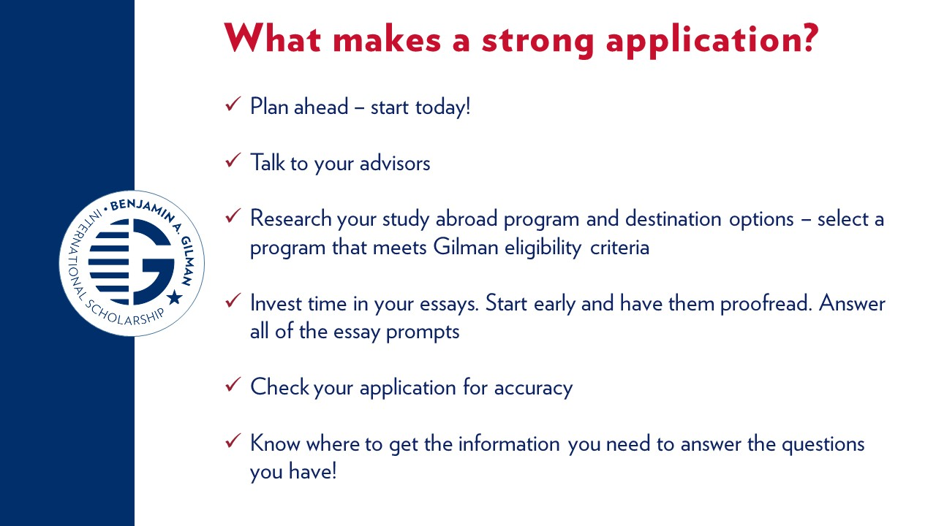
Notes:
So, you’ve decided you want to study or intern abroad, you’ve determined you’re eligible for the Gilman Scholarship, but you know that it’s competitive. You might wonder what makes a strong application? –
The best tip is to begin planning early. You will need to coordinate a lot of information related to your program abroad, your academics at home, your financial and logistical resources, as well as spend time working on your essays and actually completing the application. You also have to get a hold of your transcript, which often takes a few days.
A survey of previous applicants indicated that it takes an average of five to ten hours to complete the Gilman Scholarship application, so if you begin planning early you will be sure to have a quality application in way before the last minute.
Talk with your advisors. This goes hand in hand with planning early. Talking with your advisors will ensure that you always have up to date information about your program, and that your advisors always have up to date information about your Gilman Application.
Spend quality time on your essays. Your essays are the portion of your Gilman Application that you will be able to use to fully present yourself to the Review Panel. Because you will not meet them in person, and because the Review panel does not make any assumptions about an applicant, you must use your essays as a chance to let the panelists get to know you.
In your Statement of Purpose, talk about yourself, your academic, professional, and personal goals, any challenges you’ve faced in working towards your goals or your plan to study or intern abroad, and why this specific program abroad is a step towards your goals.
It’s important to take the opportunity in your essay to really demonstrate who you are and why you want to study/intern abroad, get across your passion and interests. A student who says they just want to go somewhere is not as compelling as a student who talks about the impact of their proposed program.
You should use your Follow On Service Project Essay to talk about your plan for “paying-it-forward”, design a plan of action that will inspire others to study or intern abroad, and use this essay to explain the audience, tools, and timeline of your project.
For both of your essays, make sure that you fully answer the prompts, that you are both creative, but realistic, and that you invest time in writing drafts, editing, and having others proofread your essays. You wouldn’t believe how many students we have every year that write “study aboard” instead of “study abroad.” The extra steps to proofread and make corrections ensures that your essays are easy to read and the panelists are able to get to know you.
Before you submit your application, you have the opportunity to review your application before you finally submit it. Take the time to check for accuracy regarding all information you’ve inputted. Putting the wrong information may cause your application to not meet eligibility requirements and therefore put you out of scholarship consideration.
These are all simple steps and works best when you start the process as early as possible, not waiting until the last minute to complete and submit! Every cycle we have students who have questions the night of the application deadline. Please know that we are not available at 10pm to answer last minute questions so make sure you take care of any issues before that time.
And finally, make sure that you stay updated.

Slide 12

Notes:
There are lots of ways to stay connected to the Gilman Program for program updates and information. The Gilman YouTube channel has videos from previous recipients, as well as instructional videos on things such as uploading transcripts and navigating the application site.
The program has informational, live webinars on Meeting Gilman Alumni as well as information for advisors.
Subscribe to the applicant e-newsletters, a four-volume series during the application cycle, that provides tips and resources.
You can also check out the Gilman Global Experience Blog, which is written by Gilman scholars while they are abroad, allowing you to see what it’s like to study abroad.
Or simply search #gilmanscholarship to see more!

Slide 13

Notes:
There are also many other resources available to you as you search for study abroad scholarships. There are resources available on the Gilman website as well as www.studyabroad.state.gov, which is an online searchable database of various study abroad scholarships. The USA Study Abroad Office website also has resources for additional opportunities including the Critical Language Scholarship, the Boren Award for International Study, Project GO, the Fulbright U.S. Student Program, and many others.

Slide 14
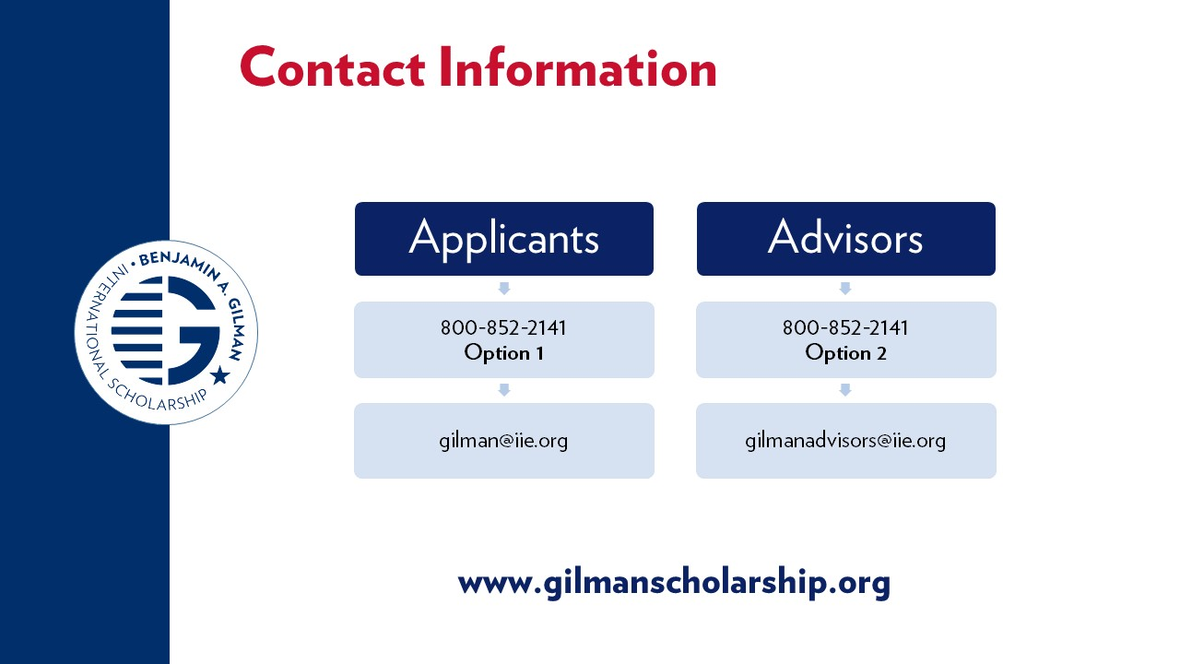
Notes:
There are also many other resources available to you as you search for study abroad scholarships. There are resources available on the Gilman website as well as www.studyabroad.state.gov, which is an online searchable database of various study abroad scholarships. The USA Study Abroad Office website also has resources for additional opportunities including the Critical Language Scholarship, the Boren Award for International Study, Project GO, the Fulbright U.S. Student Program, and many others.

